Slide 1
CPS 235 Object Oriented Programming Paradigm
Lecturer Rabia Khan
Introduction
CPS235: Introduction

Slide 2
About the course
Credit hours: 3 + 1
Pre-requisites: CPS 101
Textbook
  Object Oriented Programming in C++ by Robert Lafore
    E-book available
Reference books
  C++ How To Program, Deitel and Deitel
    E-book available
  Thinking in C++ by Bruce Eckel
    Online book available on
  http://www.mindview.net/Books/TICPP/ThinkingInCPP2e.html
Course Lecture Slides
  Will be uploaded on LMS
CPS235: Introduction

Slide 3
Course Overview
Syllabus (Subject to changes)
  Introduction
  C++ Programming Basics
  Object-Oriented Concepts
    Objects and Classes
    Operator Overloading
    Inheritance
    Polymorphism
  Pointers
  Virtual Functions
  Streams and Files
  Templates and Exceptions
  Object Oriented Software Development
  Building GUIs
CPS235: Introduction

Slide 4
Student Evaluation
Assignments (5%)
Quizzes (15%)
MidTerm (30%)
Final (50%)
  Quizzes (mostly unannounced) will be conducted quite frequently and any missed quizzes will not be re-conducted
Assignments submitted after the due date or copied will either be rejected altogether or heavily penalized
CPS235: Introduction

Slide 5
Programming Paradigms
CPS235: Introduction

Slide 6

Unstructured Programming
A program that contains only one main program
Main program stands for a sequence of commands or statements which modify data which is global throughout the whole program
Unstructured programming. The main program directly operates on global data
CPS235: Introduction

Slide 7
Unstructured Programming
This programming technique provides tremendous disadvantages once the program gets sufficiently large
For example, if the same statement sequence is needed at different locations within the program, the sequence must be copied
This has lead to the idea of extracting these sequences, naming them and offering a technique to call and return from these procedures
CPS235: Introduction

Slide 8
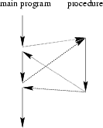
Procedural Programming
Combine returning sequences of statements into one single place
A procedure call is used to invoke the procedure
After the sequence is processed, flow of control proceeds right after the position where the call was made
CPS235: Introduction

Slide 9
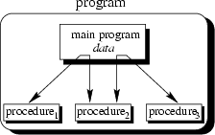
Procedural Programming
With the introduction of parameters as well as procedures of procedures ( subprocedures) programs can now be written more structured and error free
For example, if a procedure is correct, every time it is used it produces correct results
The main program is responsible to pass data to the individual calls, the data is processed by the procedures and, once the program has finished, the resulting data is presented
CPS235: Introduction

Slide 10
Procedural Programming
Now we have a single program which is divided into small pieces called procedures
Problems with Procedural Programming
  Data has to be made global to make it accessible to all functions.
  A change made in global data may necessitate rewriting in all the functions operating on that data
  Procedural paradigm does not model the real world. In real world things around you are not data and functions. They are objects which have attributes and behavior. Attributes are characteristics. Behavior is something a real world object does.
CPS235: Introduction

Slide 11
Unstructured and Procedural programming
Unstructured programming. The main program directly operates on global data
Procedural programming. The main program coordinates calls to procedures and hands over appropriate data as parameters
CPS235: Introduction

Slide 12
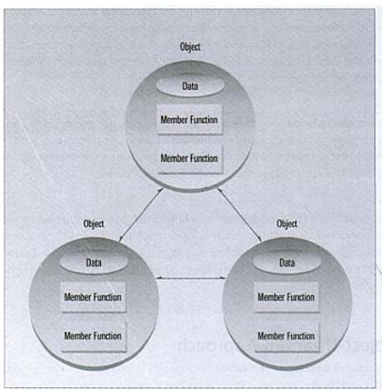
Object Oriented Programming
In the OOP approach, data and the functions, which are supposed to have the access to the data, are packed together into one box known as an object. Objects of the program interact by sending messages to each other

Slide 13
Object Oriented Programming
The data items in the objects are the attributes or the characteristics of the object.
The member functions operate on the data of the object.
Think of objects , their attributes around you.
CPS235: Introduction

Slide 14
Benefits of using OOP
Objects made in a program can be reused by any other program
  This increases the reusability of the programs once written.
The programs written in an OOP can be easily updated by using the facilities of inheritance
CPS235: Introduction

Slide 15
OOP Features
Encapsulation
Inheritance and reuse
Creating new Data types
Polymorphism and overloading
CPS235: Introduction

Slide 16
Encapsulation
Both the data, and the functionality that could affect or display that data are included under a unified name (the object name itself).
In the classic definition, the data elements (or properties of the object) are not available to the outside world directly.
Instead, methods would be created to give access to these values outside of the object
Now we have the ability to declare properties as being public or private
CPS235: Introduction

Slide 17
Inheritance and reuse
This feature allows developers to define objects in a hierarchy much like a taxonomy chart
Each level of the hierarchy defines a more specific object than the parent level
Each level inherits all the properties and methods of it's parent object and at that point you define the more specific properties and methods need by the new level of object you created
CPS235: Introduction

Slide 18
Creating new data types
OOP provides the programmer a convenient way to construct new data types
  Suppose you want to represent the location of something in the form of its x and y coordinates and want to add them using normal arithmetic operations like
  location1 = location2 + origin
  Where each of these variables represents a pair of numerical quantities
  This can be done with the help of objects and classes
CPS235: Introduction

Slide 19
Polymorphism
Polymorphism = many forms
At any level of an object hierarchy each object could have a method of the same name and because of the level at which the method resides in, it could know which of the procedures or functions to call
Hence you could have a Shape object that has a Draw method
  Then you could define a Circle, Square and Triangle object as Shape objects and override the Draw method to draw specifically a Circle, Square or Triangle method respectively
  All 4 objects would then have a Draw method but only the right method for the right object would be called
CPS235: Introduction

Slide 20
Overloading
When an existing operator such as + or = is given the capability to operate on a new data type such as our location object in the previous example then this is called Operator Overloading.
CPS235: Introduction

Slide 21
Recommended Reading
Robert Lafore, Chapter1: The Big Picture
CPS235: Introduction

